Slide 1
Fundamentals of Ecology
Week 9, Ecology Lecture 8
Cara Brook
March 2, 2023

Slide 2
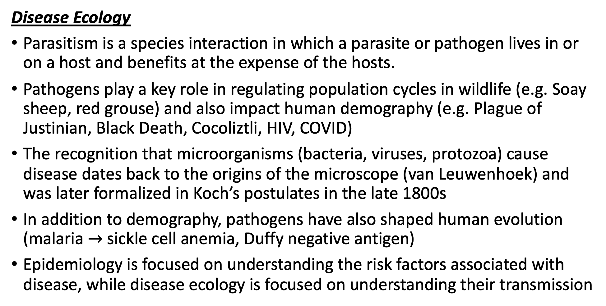
Let’s recap a bit!
Disease Ecology
Parasitism is a species interaction in which a parasite or pathogen lives in or on a host and benefits at the expense of the hosts.
Pathogens play a key role in regulating population cycles in wildlife (e.g. Soay sheep, red grouse) and also impact human demography (e.g. Plague of Justinian, Black Death, Cocoliztli, HIV, COVID)
The recognition that microorganisms (bacteria, viruses, protozoa) cause disease dates back to the origins of the microscope (van Leuwenhoek) and was later formalized in Koch’s postulates in the late 1800s
In addition to demography, pathogens have also shaped human evolution (malaria $→$ sickle cell anemia, Duffy negative antigen)
Epidemiology is focused on understanding the risk factors associated with disease, while disease ecology is focused on understanding their transmission

Slide 3
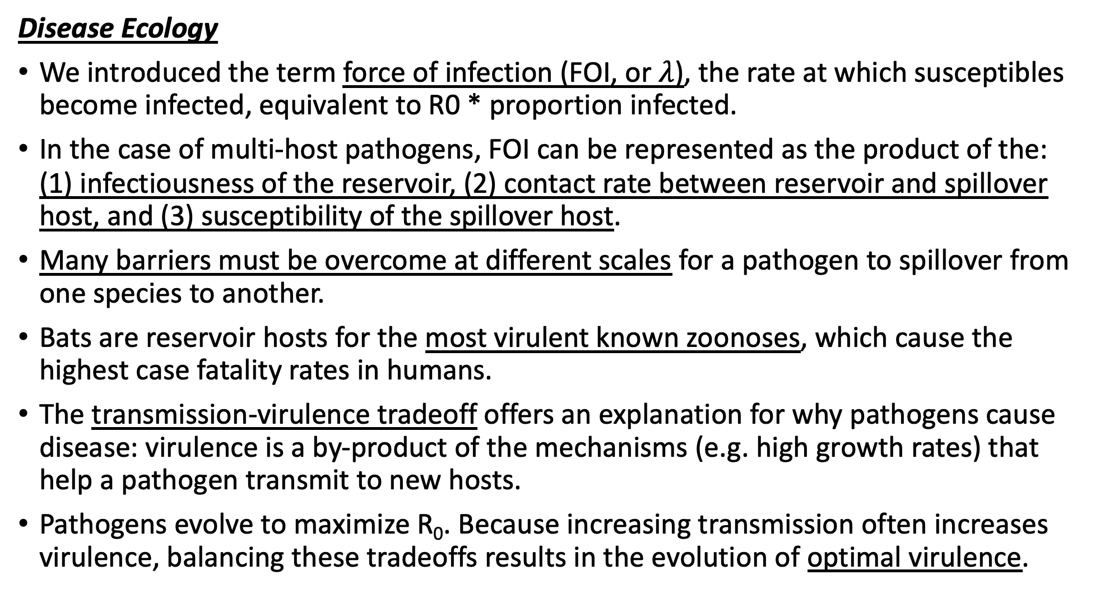
Let’s recap a bit!
Disease Ecology
We introduced the term force of infection (FOI, or $λ$), the rate at which susceptibles become infected, equivalent to R0 * proportion infected.
In the case of multi-host pathogens, FOI can be represented as the product of the: (1) infectiousness of the reservoir, (2) contact rate between reservoir and spillover host, and (3) susceptibility of the spillover host.
Many barriers must be overcome at different scales for a pathogen to spillover from one species to another.
Bats are reservoir hosts for the most virulent known zoonoses, which cause the highest case fatality rates in humans.
The transmission-virulence tradeoff offers an explanation for why pathogens cause disease: virulence is a by-product of the mechanisms (e.g. high growth rates) that help a pathogen transmit to new hosts.
Pathogens evolve to maximize R₀. Because increasing transmission often increases virulence, balancing these tradeoffs results in the evolution of optimal virulence.
Disease Ecology
Parasitism is a species interaction in which a parasite or pathogen lives in or on a host and benefits at the expense of the hosts.
Pathogens play a key role in regulating population cycles in wildlife (e.g. Soay sheep, red grouse) and also impact human demography (e.g. Plague of Justinian, Black Death, Cocoliztli, HIV, COVID)
The recognition that microorganisms (bacteria, viruses, protozoa) cause disease dates back to the origins of the microscope (van Leuwenhoek) and was later formalized in Koch’s postulates in the late 1800s
In addition to demography, pathogens have also shaped human evolution (malaria $→$ sickle cell anemia, Duffy negative antigen)
Epidemiology is focused on understanding the risk factors associated with disease, while disease ecology is focused on understanding their transmission

Slide 4
Let’s recap a bit!
Disease Ecology
We introduced the term force of infection (FOI, or $λ$), the rate at which susceptibles become infected, equivalent to R0 * proportion infected.
In the case of multi-host pathogens, FOI can be represented as the product of the: (1) infectiousness of the reservoir, (2) contact rate between reservoir and spillover host, and (3) susceptibility of the spillover host.
Many barriers must be overcome at different scales for a pathogen to spillover from one species to another.
Bats are reservoir hosts for the most virulent known zoonoses, which cause the highest case fatality rates in humans.
The transmission-virulence tradeoff offers an explanation for why pathogens cause disease: virulence is a by-product of the mechanisms (e.g. high growth rates) that help a pathogen transmit to new hosts.
Pathogens evolve to maximize R₀. Because increasing transmission often increases virulence, balancing these tradeoffs results in the evolution of optimal virulence.
Disease Ecology
Parasitism is a species interaction in which a parasite or pathogen lives in or on a host and benefits at the expense of the hosts.
Pathogens play a key role in regulating population cycles in wildlife (e.g. Soay sheep, red grouse) and also impact human demography (e.g. Plague of Justinian, Black Death, Cocoliztli, HIV, COVID)
The recognition that microorganisms (bacteria, viruses, protozoa) cause disease dates back to the origins of the microscope (van Leuwenhoek) and was later formalized in Koch’s postulates in the late 1800s
In addition to demography, pathogens have also shaped human evolution (malaria $→$ sickle cell anemia, Duffy negative antigen)
Epidemiology is focused on understanding the risk factors associated with disease, while disease ecology is focused on understanding their transmission

Slide 5
Let’s recap a bit!
Disease Ecology
We introduced the term force of infection (FOI, or $λ$), the rate at which susceptibles become infected, equivalent to R0 * proportion infected.
In the case of multi-host pathogens, FOI can be represented as the product of the: (1) infectiousness of the reservoir, (2) contact rate between reservoir and spillover host, and (3) susceptibility of the spillover host.
Many barriers must be overcome at different scales for a pathogen to spillover from one species to another.
Bats are reservoir hosts for the most virulent known zoonoses, which cause the highest case fatality rates in humans.
The transmission-virulence tradeoff offers an explanation for why pathogens cause disease: virulence is a by-product of the mechanisms (e.g. high growth rates) that help a pathogen transmit to new hosts.
Pathogens evolve to maximize R₀. Because increasing transmission often increases virulence, balancing these tradeoffs results in the evolution of optimal virulence.
Disease Ecology
Parasitism is a species interaction in which a parasite or pathogen lives in or on a host and benefits at the expense of the hosts.
Pathogens play a key role in regulating population cycles in wildlife (e.g. Soay sheep, red grouse) and also impact human demography (e.g. Plague of Justinian, Black Death, Cocoliztli, HIV, COVID)
The recognition that microorganisms (bacteria, viruses, protozoa) cause disease dates back to the origins of the microscope (van Leuwenhoek) and was later formalized in Koch’s postulates in the late 1800s
In addition to demography, pathogens have also shaped human evolution (malaria $→$ sickle cell anemia, Duffy negative antigen)
Epidemiology is focused on understanding the risk factors associated with disease, while disease ecology is focused on understanding their transmission

Slide 6
Let’s recap a bit!
Disease Ecology
We introduced the term force of infection (FOI, or $λ$), the rate at which susceptibles become infected, equivalent to R0 * proportion infected.
In the case of multi-host pathogens, FOI can be represented as the product of the: (1) infectiousness of the reservoir, (2) contact rate between reservoir and spillover host, and (3) susceptibility of the spillover host.
Many barriers must be overcome at different scales for a pathogen to spillover from one species to another.
Bats are reservoir hosts for the most virulent known zoonoses, which cause the highest case fatality rates in humans.
The transmission-virulence tradeoff offers an explanation for why pathogens cause disease: virulence is a by-product of the mechanisms (e.g. high growth rates) that help a pathogen transmit to new hosts.
Pathogens evolve to maximize R₀. Because increasing transmission often increases virulence, balancing these tradeoffs results in the evolution of optimal virulence.
Disease Ecology
Parasitism is a species interaction in which a parasite or pathogen lives in or on a host and benefits at the expense of the hosts.
Pathogens play a key role in regulating population cycles in wildlife (e.g. Soay sheep, red grouse) and also impact human demography (e.g. Plague of Justinian, Black Death, Cocoliztli, HIV, COVID)
The recognition that microorganisms (bacteria, viruses, protozoa) cause disease dates back to the origins of the microscope (van Leuwenhoek) and was later formalized in Koch’s postulates in the late 1800s
In addition to demography, pathogens have also shaped human evolution (malaria $→$ sickle cell anemia, Duffy negative antigen)
Epidemiology is focused on understanding the risk factors associated with disease, while disease ecology is focused on understanding their transmission

Slide 7
Let’s recap a bit!
Disease Ecology
We introduced the term force of infection (FOI, or $λ$), the rate at which susceptibles become infected, equivalent to R0 * proportion infected.
In the case of multi-host pathogens, FOI can be represented as the product of the: (1) infectiousness of the reservoir, (2) contact rate between reservoir and spillover host, and (3) susceptibility of the spillover host.
Many barriers must be overcome at different scales for a pathogen to spillover from one species to another.
Bats are reservoir hosts for the most virulent known zoonoses, which cause the highest case fatality rates in humans.
The transmission-virulence tradeoff offers an explanation for why pathogens cause disease: virulence is a by-product of the mechanisms (e.g. high growth rates) that help a pathogen transmit to new hosts.
Pathogens evolve to maximize R₀. Because increasing transmission often increases virulence, balancing these tradeoffs results in the evolution of optimal virulence.
Disease Ecology
Parasitism is a species interaction in which a parasite or pathogen lives in or on a host and benefits at the expense of the hosts.
Pathogens play a key role in regulating population cycles in wildlife (e.g. Soay sheep, red grouse) and also impact human demography (e.g. Plague of Justinian, Black Death, Cocoliztli, HIV, COVID)
The recognition that microorganisms (bacteria, viruses, protozoa) cause disease dates back to the origins of the microscope (van Leuwenhoek) and was later formalized in Koch’s postulates in the late 1800s
In addition to demography, pathogens have also shaped human evolution (malaria $→$ sickle cell anemia, Duffy negative antigen)
Epidemiology is focused on understanding the risk factors associated with disease, while disease ecology is focused on understanding their transmission

Slide 8
Let’s recap a bit!
Disease Ecology
We introduced the term force of infection (FOI, or $λ$), the rate at which susceptibles become infected, equivalent to R0 * proportion infected.
In the case of multi-host pathogens, FOI can be represented as the product of the: (1) infectiousness of the reservoir, (2) contact rate between reservoir and spillover host, and (3) susceptibility of the spillover host.
Many barriers must be overcome at different scales for a pathogen to spillover from one species to another.
Bats are reservoir hosts for the most virulent known zoonoses, which cause the highest case fatality rates in humans.
The transmission-virulence tradeoff offers an explanation for why pathogens cause disease: virulence is a by-product of the mechanisms (e.g. high growth rates) that help a pathogen transmit to new hosts.
Pathogens evolve to maximize R₀. Because increasing transmission often increases virulence, balancing these tradeoffs results in the evolution of optimal virulence.
Disease Ecology
Parasitism is a species interaction in which a parasite or pathogen lives in or on a host and benefits at the expense of the hosts.
Pathogens play a key role in regulating population cycles in wildlife (e.g. Soay sheep, red grouse) and also impact human demography (e.g. Plague of Justinian, Black Death, Cocoliztli, HIV, COVID)
The recognition that microorganisms (bacteria, viruses, protozoa) cause disease dates back to the origins of the microscope (van Leuwenhoek) and was later formalized in Koch’s postulates in the late 1800s
In addition to demography, pathogens have also shaped human evolution (malaria $→$ sickle cell anemia, Duffy negative antigen)
Epidemiology is focused on understanding the risk factors associated with disease, while disease ecology is focused on understanding their transmission

Slide 9
Let’s recap a bit!
Disease Ecology
Parasitism is a species interaction in which a parasite or pathogen lives in or on a host and benefits at the expense of the hosts.
Pathogens play a key role in regulating population cycles in wildlife (e.g. Soay sheep, red grouse) and also impact human demography (e.g. Plague of Justinian, Black Death, Cocoliztli, HIV, COVID)
The recognition that microorganisms (bacteria, viruses, protozoa) cause disease dates back to the origins of the microscope (van Leuwenhoek) and was later formalized in Koch’s postulates in the late 1800s
In addition to demography, pathogens have also shaped human evolution (malaria $→$ sickle cell anemia, Duffy negative antigen)
Epidemiology is focused on understanding the risk factors associated with disease, while disease ecology is focused on understanding their transmission
We discussed a few examples of the transmission-virulence tradeoff: myxoma virus in rabbits, and a protozoan parasite of Monarch butterflies.
Bat viruses optimize growth rates to be avirulent in their bat reservoir but, because of bat virus tolerance, these can cause extreme disease after spillover to humans.
In a spatial context, virulence tends to be reduced when transmission is local – but in certain cases, high virulence strains can still be maintained.
Imperfect vaccines, especially those targeting pathogen growth rates, can also result in the evolution of virulent pathogens.
Phylodynamics is the field of using phylogenetics to understand disease transmission
The “dilution effect” offers a hypothesis about the disease-buffering services of biodiversity. This works well for the case study of Lyme disease, but in actuality, biodiversity more often enhances rather than dilutes transmission.
The result of amplification vs. dilution depends on the ratio of competent to non-competent hosts and the abundance of the vector population.

Slide 10
Let’s recap a bit!
Disease Ecology
Parasitism is a species interaction in which a parasite or pathogen lives in or on a host and benefits at the expense of the hosts.
Pathogens play a key role in regulating population cycles in wildlife (e.g. Soay sheep, red grouse) and also impact human demography (e.g. Plague of Justinian, Black Death, Cocoliztli, HIV, COVID)
The recognition that microorganisms (bacteria, viruses, protozoa) cause disease dates back to the origins of the microscope (van Leuwenhoek) and was later formalized in Koch’s postulates in the late 1800s
In addition to demography, pathogens have also shaped human evolution (malaria $→$ sickle cell anemia, Duffy negative antigen)
Epidemiology is focused on understanding the risk factors associated with disease, while disease ecology is focused on understanding their transmission
We discussed a few examples of the transmission-virulence tradeoff: myxoma virus in rabbits, and a protozoan parasite of Monarch butterflies.
Bat viruses optimize growth rates to be avirulent in their bat reservoir but, because of bat virus tolerance, these can cause extreme disease after spillover to humans.
In a spatial context, virulence tends to be reduced when transmission is local – but in certain cases, high virulence strains can still be maintained.
Imperfect vaccines, especially those targeting pathogen growth rates, can also result in the evolution of virulent pathogens.
Phylodynamics is the field of using phylogenetics to understand disease transmission
The “dilution effect” offers a hypothesis about the disease-buffering services of biodiversity. This works well for the case study of Lyme disease, but in actuality, biodiversity more often enhances rather than dilutes transmission.
The result of amplification vs. dilution depends on the ratio of competent to non-competent hosts and the abundance of the vector population.

Slide 11
Let’s recap a bit!
Disease Ecology
Parasitism is a species interaction in which a parasite or pathogen lives in or on a host and benefits at the expense of the hosts.
Pathogens play a key role in regulating population cycles in wildlife (e.g. Soay sheep, red grouse) and also impact human demography (e.g. Plague of Justinian, Black Death, Cocoliztli, HIV, COVID)
The recognition that microorganisms (bacteria, viruses, protozoa) cause disease dates back to the origins of the microscope (van Leuwenhoek) and was later formalized in Koch’s postulates in the late 1800s
In addition to demography, pathogens have also shaped human evolution (malaria $→$ sickle cell anemia, Duffy negative antigen)
Epidemiology is focused on understanding the risk factors associated with disease, while disease ecology is focused on understanding their transmission
We discussed a few examples of the transmission-virulence tradeoff: myxoma virus in rabbits, and a protozoan parasite of Monarch butterflies.
Bat viruses optimize growth rates to be avirulent in their bat reservoir but, because of bat virus tolerance, these can cause extreme disease after spillover to humans.
In a spatial context, virulence tends to be reduced when transmission is local – but in certain cases, high virulence strains can still be maintained.
Imperfect vaccines, especially those targeting pathogen growth rates, can also result in the evolution of virulent pathogens.
Phylodynamics is the field of using phylogenetics to understand disease transmission
The “dilution effect” offers a hypothesis about the disease-buffering services of biodiversity. This works well for the case study of Lyme disease, but in actuality, biodiversity more often enhances rather than dilutes transmission.
The result of amplification vs. dilution depends on the ratio of competent to non-competent hosts and the abundance of the vector population.

Slide 12
Let’s recap a bit!
Disease Ecology
Parasitism is a species interaction in which a parasite or pathogen lives in or on a host and benefits at the expense of the hosts.
Pathogens play a key role in regulating population cycles in wildlife (e.g. Soay sheep, red grouse) and also impact human demography (e.g. Plague of Justinian, Black Death, Cocoliztli, HIV, COVID)
The recognition that microorganisms (bacteria, viruses, protozoa) cause disease dates back to the origins of the microscope (van Leuwenhoek) and was later formalized in Koch’s postulates in the late 1800s
In addition to demography, pathogens have also shaped human evolution (malaria $→$ sickle cell anemia, Duffy negative antigen)
Epidemiology is focused on understanding the risk factors associated with disease, while disease ecology is focused on understanding their transmission
We discussed a few examples of the transmission-virulence tradeoff: myxoma virus in rabbits, and a protozoan parasite of Monarch butterflies.
Bat viruses optimize growth rates to be avirulent in their bat reservoir but, because of bat virus tolerance, these can cause extreme disease after spillover to humans.
In a spatial context, virulence tends to be reduced when transmission is local – but in certain cases, high virulence strains can still be maintained.
Imperfect vaccines, especially those targeting pathogen growth rates, can also result in the evolution of virulent pathogens.
Phylodynamics is the field of using phylogenetics to understand disease transmission
The “dilution effect” offers a hypothesis about the disease-buffering services of biodiversity. This works well for the case study of Lyme disease, but in actuality, biodiversity more often enhances rather than dilutes transmission.
The result of amplification vs. dilution depends on the ratio of competent to non-competent hosts and the abundance of the vector population.

Slide 13
Let’s recap a bit!
Disease Ecology
Parasitism is a species interaction in which a parasite or pathogen lives in or on a host and benefits at the expense of the hosts.
Pathogens play a key role in regulating population cycles in wildlife (e.g. Soay sheep, red grouse) and also impact human demography (e.g. Plague of Justinian, Black Death, Cocoliztli, HIV, COVID)
The recognition that microorganisms (bacteria, viruses, protozoa) cause disease dates back to the origins of the microscope (van Leuwenhoek) and was later formalized in Koch’s postulates in the late 1800s
In addition to demography, pathogens have also shaped human evolution (malaria $→$ sickle cell anemia, Duffy negative antigen)
Epidemiology is focused on understanding the risk factors associated with disease, while disease ecology is focused on understanding their transmission
We discussed a few examples of the transmission-virulence tradeoff: myxoma virus in rabbits, and a protozoan parasite of Monarch butterflies.
Bat viruses optimize growth rates to be avirulent in their bat reservoir but, because of bat virus tolerance, these can cause extreme disease after spillover to humans.
In a spatial context, virulence tends to be reduced when transmission is local – but in certain cases, high virulence strains can still be maintained.
Imperfect vaccines, especially those targeting pathogen growth rates, can also result in the evolution of virulent pathogens.
Phylodynamics is the field of using phylogenetics to understand disease transmission
The “dilution effect” offers a hypothesis about the disease-buffering services of biodiversity. This works well for the case study of Lyme disease, but in actuality, biodiversity more often enhances rather than dilutes transmission.
The result of amplification vs. dilution depends on the ratio of competent to non-competent hosts and the abundance of the vector population.

Slide 14
Let’s recap a bit!
Disease Ecology
Parasitism is a species interaction in which a parasite or pathogen lives in or on a host and benefits at the expense of the hosts.
Pathogens play a key role in regulating population cycles in wildlife (e.g. Soay sheep, red grouse) and also impact human demography (e.g. Plague of Justinian, Black Death, Cocoliztli, HIV, COVID)
The recognition that microorganisms (bacteria, viruses, protozoa) cause disease dates back to the origins of the microscope (van Leuwenhoek) and was later formalized in Koch’s postulates in the late 1800s
In addition to demography, pathogens have also shaped human evolution (malaria $→$ sickle cell anemia, Duffy negative antigen)
Epidemiology is focused on understanding the risk factors associated with disease, while disease ecology is focused on understanding their transmission
We discussed a few examples of the transmission-virulence tradeoff: myxoma virus in rabbits, and a protozoan parasite of Monarch butterflies.
Bat viruses optimize growth rates to be avirulent in their bat reservoir but, because of bat virus tolerance, these can cause extreme disease after spillover to humans.
In a spatial context, virulence tends to be reduced when transmission is local – but in certain cases, high virulence strains can still be maintained.
Imperfect vaccines, especially those targeting pathogen growth rates, can also result in the evolution of virulent pathogens.
Phylodynamics is the field of using phylogenetics to understand disease transmission
The “dilution effect” offers a hypothesis about the disease-buffering services of biodiversity. This works well for the case study of Lyme disease, but in actuality, biodiversity more often enhances rather than dilutes transmission.
The result of amplification vs. dilution depends on the ratio of competent to non-competent hosts and the abundance of the vector population.

Slide 15
Let’s recap a bit!
Disease Ecology
Parasitism is a species interaction in which a parasite or pathogen lives in or on a host and benefits at the expense of the hosts.
Pathogens play a key role in regulating population cycles in wildlife (e.g. Soay sheep, red grouse) and also impact human demography (e.g. Plague of Justinian, Black Death, Cocoliztli, HIV, COVID)
The recognition that microorganisms (bacteria, viruses, protozoa) cause disease dates back to the origins of the microscope (van Leuwenhoek) and was later formalized in Koch’s postulates in the late 1800s
In addition to demography, pathogens have also shaped human evolution (malaria $→$ sickle cell anemia, Duffy negative antigen)
Epidemiology is focused on understanding the risk factors associated with disease, while disease ecology is focused on understanding their transmission
We discussed a few examples of the transmission-virulence tradeoff: myxoma virus in rabbits, and a protozoan parasite of Monarch butterflies.
Bat viruses optimize growth rates to be avirulent in their bat reservoir but, because of bat virus tolerance, these can cause extreme disease after spillover to humans.
In a spatial context, virulence tends to be reduced when transmission is local – but in certain cases, high virulence strains can still be maintained.
Imperfect vaccines, especially those targeting pathogen growth rates, can also result in the evolution of virulent pathogens.
Phylodynamics is the field of using phylogenetics to understand disease transmission
The “dilution effect” offers a hypothesis about the disease-buffering services of biodiversity. This works well for the case study of Lyme disease, but in actuality, biodiversity more often enhances rather than dilutes transmission.
The result of amplification vs. dilution depends on the ratio of competent to non-competent hosts and the abundance of the vector population.

Slide 16
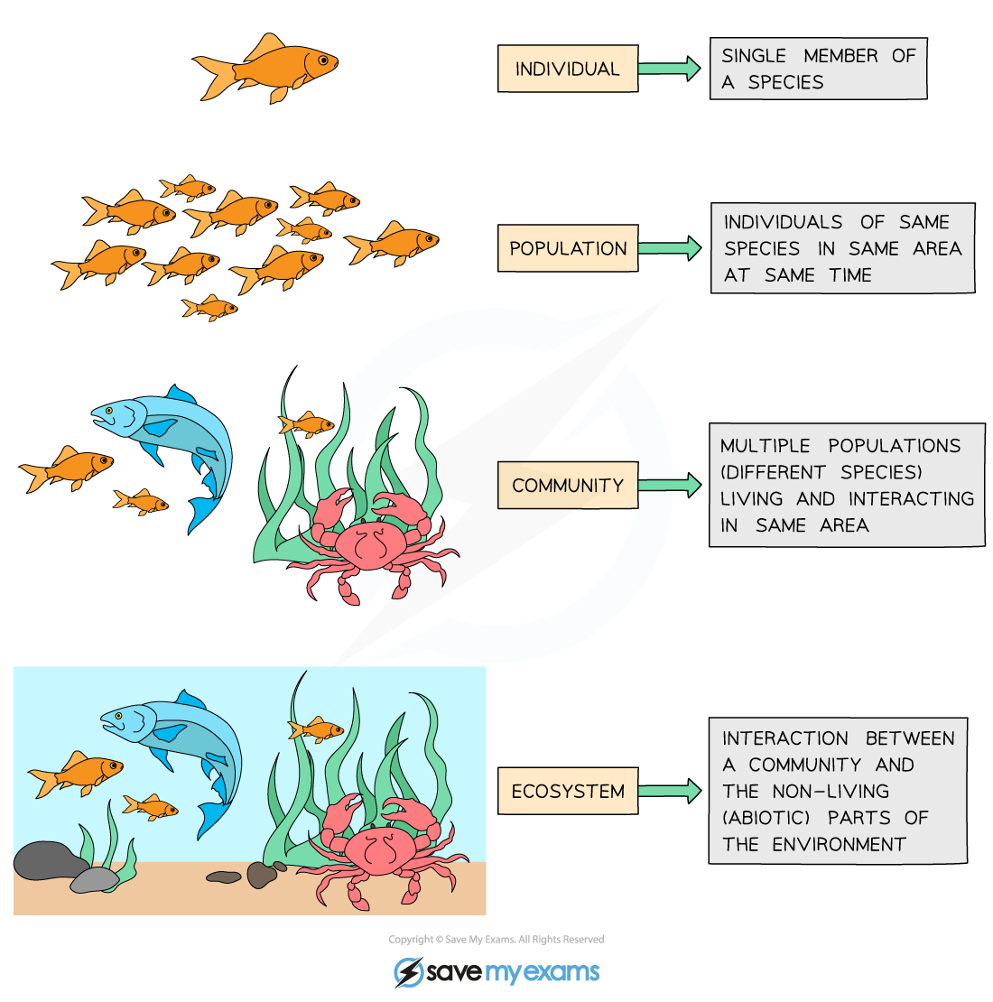
Ecology is the study of the interactions of organisms with each other and their environment.
individual
population
metapopulation
community
ecosystem
Notes:
We explore ecology – using models – across scales

Slide 17
individual
Individual: metabolism, behavior, life history.
interactions of an individual with the environment
population
metapopulation
community
ecosystem
Notes:
At the bottom, there is the level of the individual. Since ecology concerns interactions of organisms with each other and the environment, here we means how an in individual interacts with the environment

Slide 18
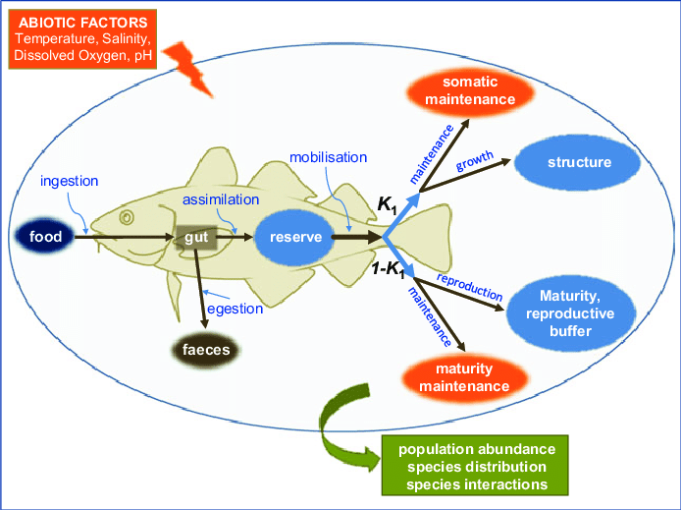
individual
Individual: metabolism, behavior, life history.
Dynamic Energy Budget (DEB) Model
population
metapopulation
How does a fish’s metabolism change with temperature?
community
ecosystem
McKenzie et al 2016. Conservation Physiology
Notes:
Interactions of an individual with the environment

Slide 19
individual
Population = multiple individuals of the same species (conspecifics) in the same habitat
population
metapopulation
community
ecosystem
Notes:
Then, we scale up to the population

Slide 20
individual
Population = multiple individuals of the same species (conspecifics) in the same habitat
population
metapopulation
fish
(x)
community
How does the abundance of fish change through time?
ecosystem

Slide 21
Nested Models, including a class of model known as Integral Projection Models (IPMs), link individual- and population-level processes
individual
population
metapopulation
fish
(x)
community
How does the abundance of fish change through time as temperature changes metabolism?
ecosystem

Slide 22
Metapopulation = sub-populations of conspecifics connected by migration or dispersal
individual
population
metapopulation
community
ecosystem
Notes:
Then to the metapop

Slide 23
Metapopulation = sub-populations of conspecifics connected by migration or dispersal
individual
population
fish₁
(x₁)
metapopulation
fish₂
(x₂)
community
How do the abundances of different subpopulations of the same fish vary in space [and time]?
fish₃
(x₃)
ecosystem
Notes:
Then to the metapop

Slide 24
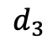
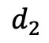
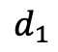
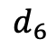
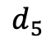
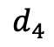
Metapopulation = sub-populations of conspecifics connected by migration or dispersal
individual
population
1
$$d_{1}$$
starfish₁
(x₁)
$$d_{2}$$
metapopulation
2
1
$$d_{6}$$
starfish₂
(x₂)
community
$$d_{5}$$
$$d_{3}$$
3
2
How do the abundances of different subpopulations of the same fish vary in space [and time]?
starfish₃
(x₃)
ecosystem
$$d_{4}$$
3

Slide 25
Community = interacting populations of different species
individual
population
metapopulation
community
ecosystem
Notes:
Then, we look at interactions between species

Slide 26
Community = interacting populations of different species
individual
population
fish
(x)
metapopulation
shark
(y)
community
How does fish abundance vary with changes in shark abundance?
ecosystem

Slide 27
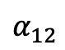
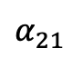
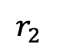
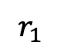
Community = interacting populations of different species
individual
population
$$α_{12}$$
$$r_{1}$$
metapopulation
Fish A
(x₁)
Fish B
(x₂)
$$r_{2}$$
community
$$α_{21}$$
How does the abundance of fish species A vary with changes in the abundance of fish species B?
ecosystem

Slide 28
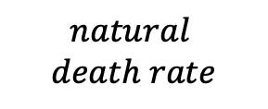
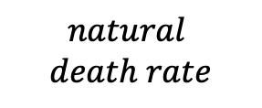
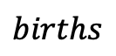
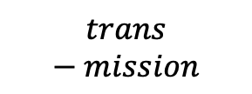
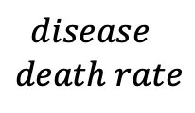
Community = interacting populations of different species
individual
population
$$births$$
Healthy
Fish
(susceptible)
$$trans−mission$$
Sick Fish (infected)
$$disease$$
$$death rate$$
metapopulation
$$natural$$
$$death rate$$
$$natural$$
$$death rate$$
community
How does the abundance of fish change based on infection with Mycobacterium marinum (wasting disease)?
ecosystem

Slide 29
Ecosystem = communities interacting with the abiotic environment
individual
population
metapopulation
community
ecosystem
Notes:
And finally how multiple species interact with each other – and with the environment

Slide 30
Ecosystem = communities interacting with the abiotic environment
individual
population
fish
(x)
metapopulation
(t)
shark
(y)
community
How does fish abundance vary with changes in shark birth rates with temperature?
ecosystem
Notes:
And finally how multiple species interact with each other – and with the environment

Slide 31
Ecosystem = communities interacting with the abiotic environment
individual
population
There is often less emphasis on the box model approach and more of a conceptual model approach to explain the distribution and abundance of species in space and time
metapopulation
community
ecosystem
Notes:
At the bottom, there is the level of the individual. Since ecology concerns interactions of organisms with each other and the environment, here we means how an in individual interacts with the environment

Slide 32
Ecosystem = communities interacting with the abiotic environment
individual
population
There is often less emphasis on the box model approach and more of a conceptual model approach to explain the distribution and abundance of species in space and time
metapopulation
community
How do communities assemble?
Do they end up the same in different environments?
ecosystem
Notes:
At the bottom, there is the level of the individual. Since ecology concerns interactions of organisms with each other and the environment, here we means how an in individual interacts with the environment

Slide 33
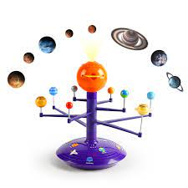
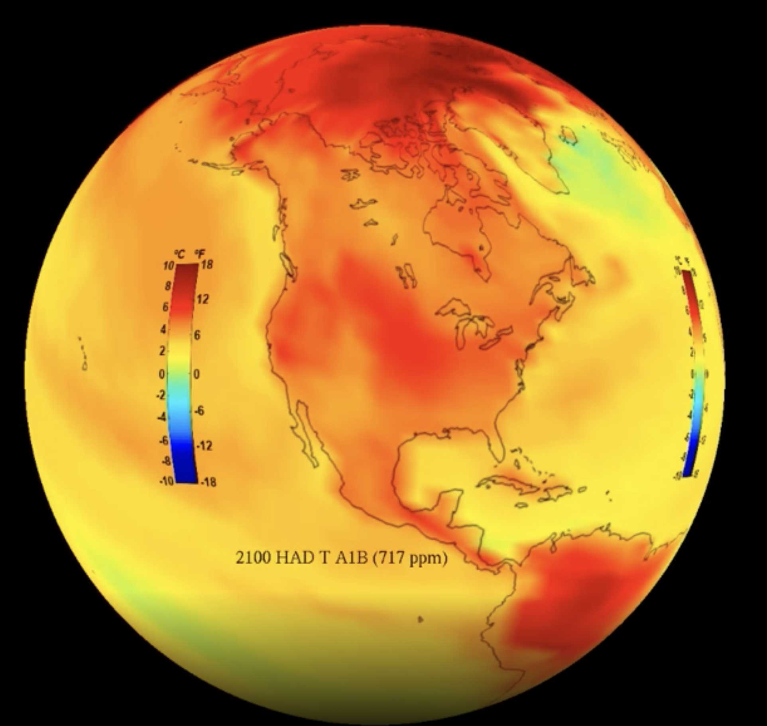

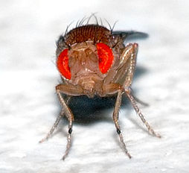
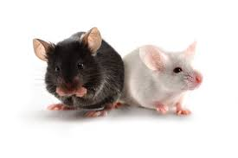
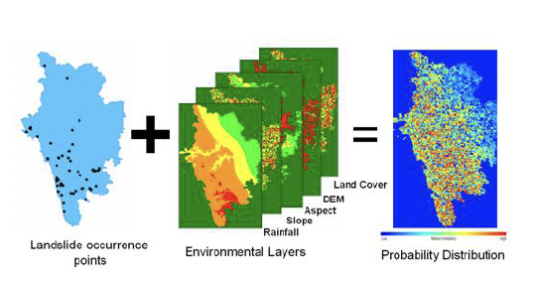
What is a model?
an abstract representation of a phenomenon
Solar System
Climate
Human
Human Genetics
Human Disease
Species Distribution
Notes:
an abstract representation of a phenomenon

Slide 34
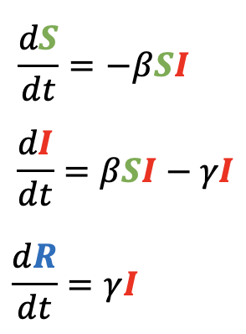
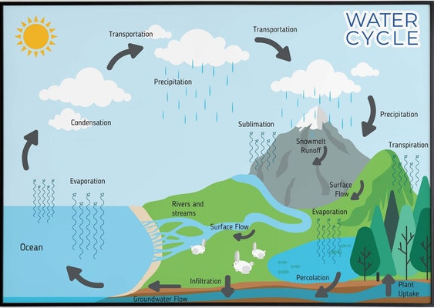
What is a model?
an abstract representation of a phenomenon
Human
Solar System
Mathematical
Human Genetics
Human Disease
Conceptual
Notes:
an abstract representation of a phenomenon

Slide 35
Community assembly is the study of the processes that shape the identity and abundance of species within ecological communities.

Slide 36
Community assembly is the study of the processes that shape the identity and abundance of species within ecological communities.
One process of community assembly is ecological succession.

Slide 37
One process of community assembly is ecological succession.
Succession is the process of change in the species structure of ecological communities with time.

Slide 38
One process of community assembly is ecological succession.
Succession is the process of change in the species structure of ecological communities with time.
Community begins with pioneer species, then develops with increasing complexity that self-reinforces to establish a climax community.

Slide 39
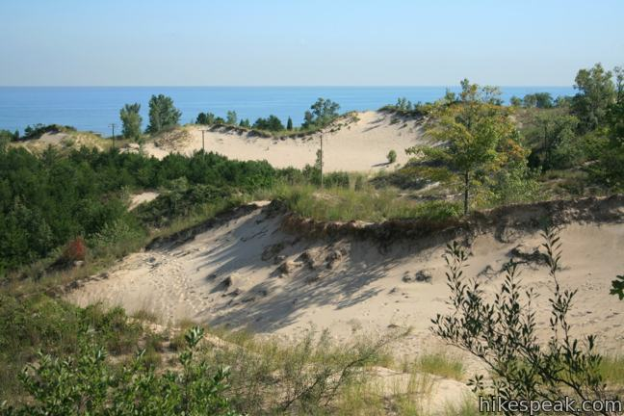
One process of community assembly is ecological succession.
Succession is the process of change in the species structure of ecological communities with time.
Community begins with pioneer species, then develops with increasing complexity that self-reinforces to establish a climax community.
Henry Chandler Cowles, a professor at the University of Chicago, developed the first formal concept of succession while observing vegetation on dunes of different ages at the Indiana Dunes. Differently aged dunes offered a proxy for time.

Slide 40
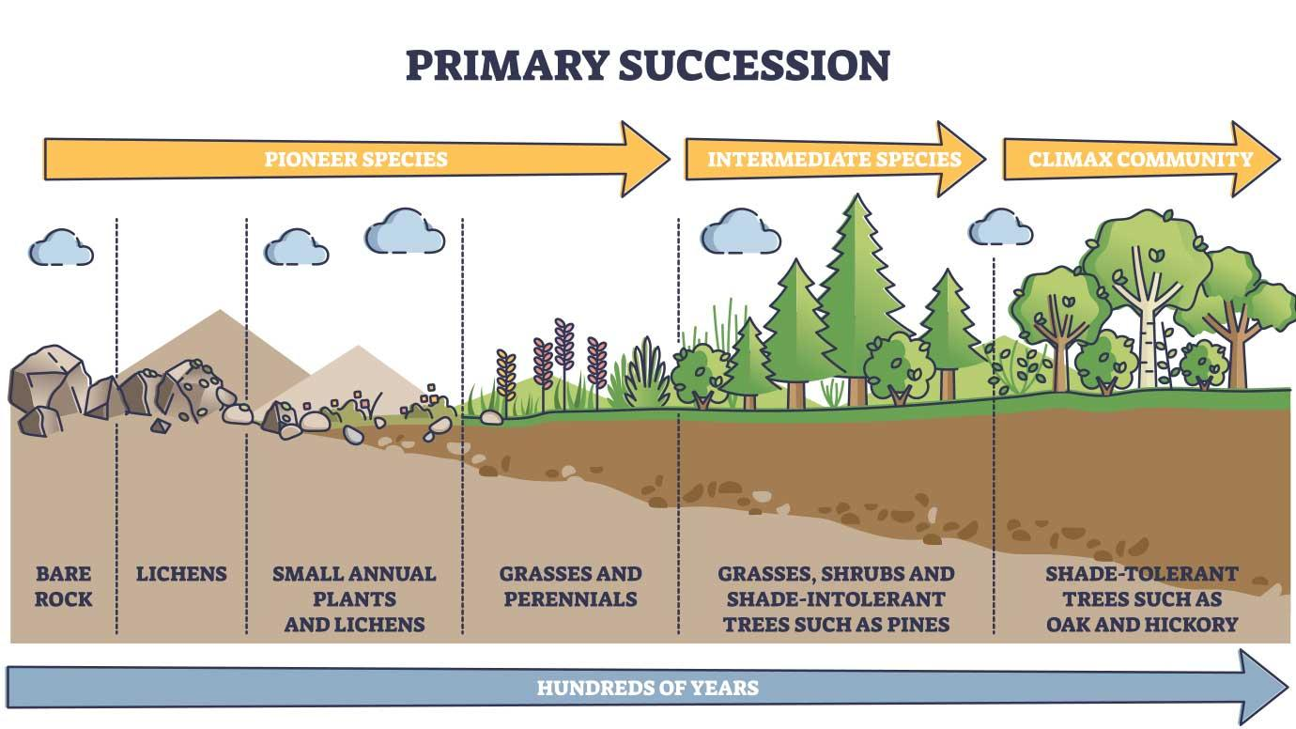
Primary succession occurs when species colonize a bare substrate.

Slide 41
Primary succession occurs when species colonize a bare substrate.
Continuum from “r-selected” $→$ “K-selected” species.

Slide 42
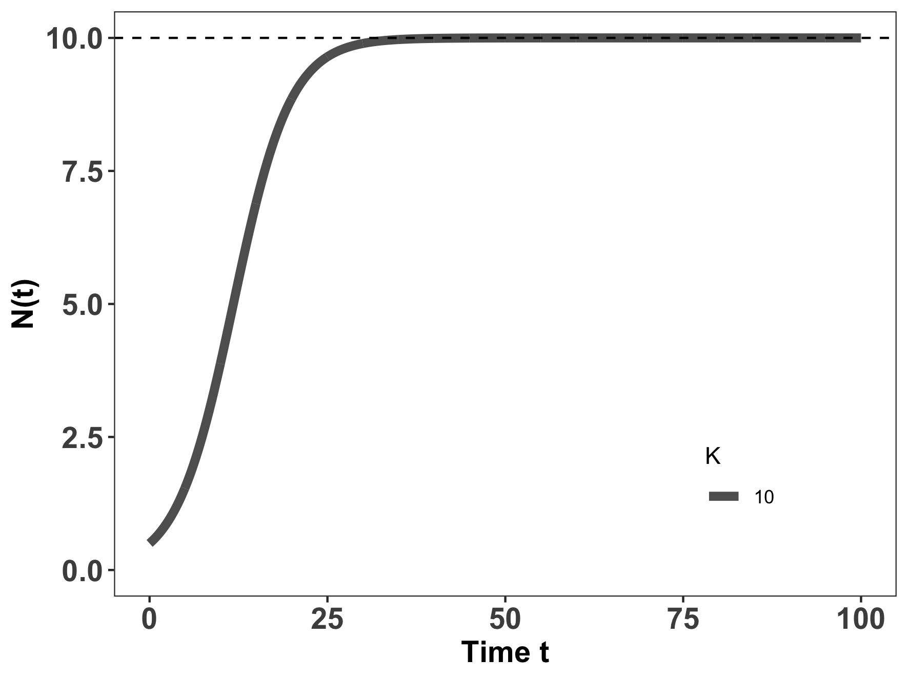
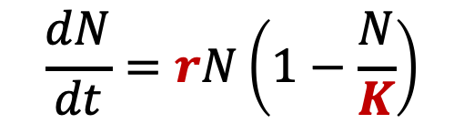
Primary succession occurs when species colonize a bare substrate.
K-selected species
r-selected species
$$\frac{dN}{dt}=rN\left(1−\frac{N}{K}\right)$$
Continuum from “r-selected” $→$ “K-selected” species.

Slide 43
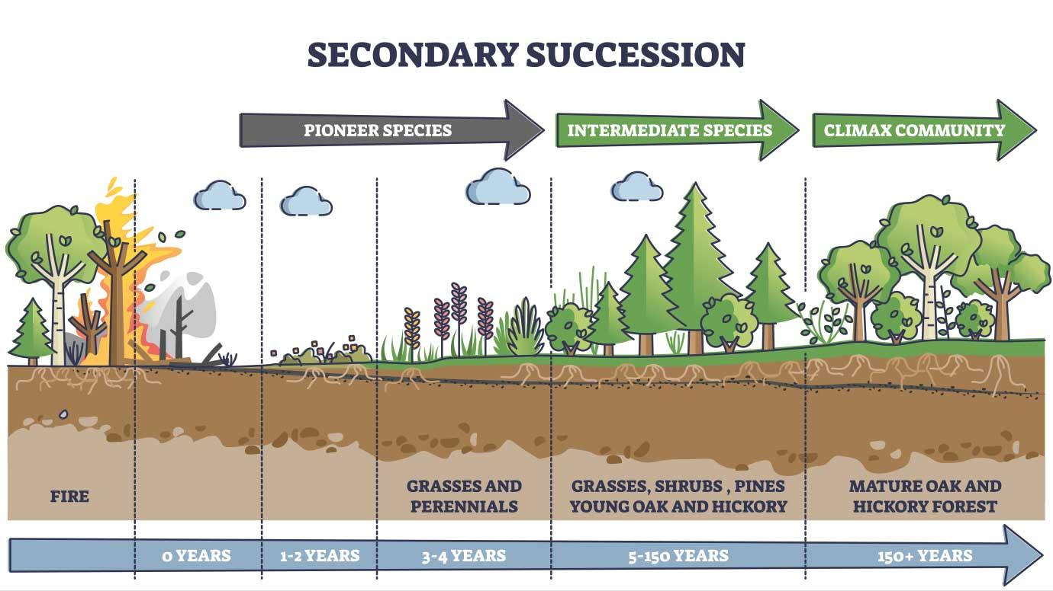
Secondary succession occurs when an environmental disturbance displaces a climax community, but soil and nutrients are still retained.

Slide 44
Secondary succession occurs when an environmental disturbance displaces a climax community, but soil and nutrients are still retained.
Continuum from “r-selected” $→$ “K-selected” species.

Slide 45
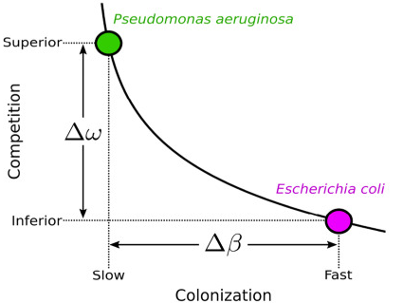
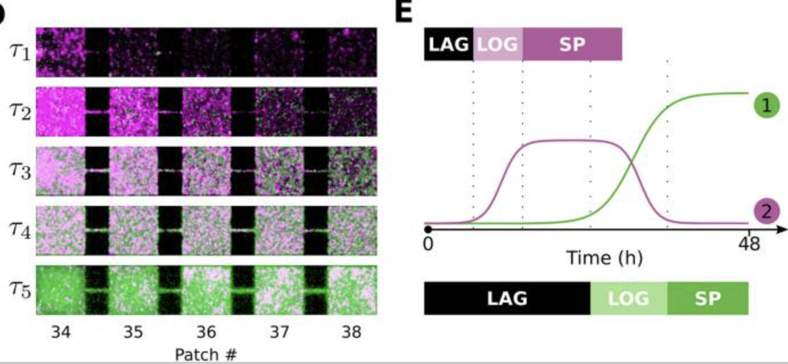
Succession also occurs in microbial systems.
Here, the “K-selected” superior competitor eventually replaces the “r-selected” fast colonizer.
Wetherington et al. 2022. BMC Biology

Slide 46
Superorganisms vs. Loose Collections of Species
Frederic Clements (1916) argued that community succession was predictable and deterministic, much like ontogenetic development in individual organisms, moving always towards some superorganism.

Slide 47
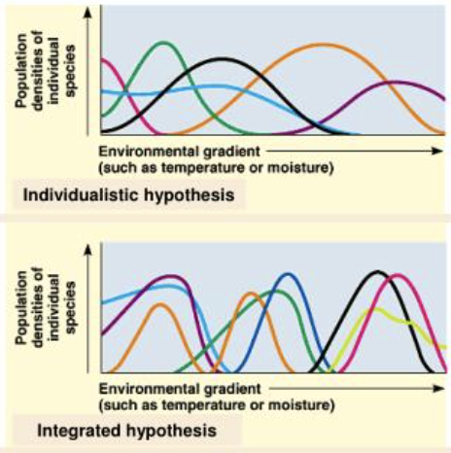
Superorganisms vs. Loose Collections of Species
Frederic Clements (1916) argued that community succession was predictable and deterministic, much like ontogenetic development in individual organisms, moving always towards some superorganism.
Priority effects: inhibitory or facilitative priority effects occur when one species ”prepares” the environment for the next species in succession

Slide 48
Superorganisms vs. Loose Collections of Species
Frederic Clements (1916) argued that community succession was predictable and deterministic, much like ontogenetic development in individual organisms, moving always towards some superorganism.
Priority effects: inhibitory or facilitative priority effects occur when one species ”prepares” the environment for the next species in succession
Henry Gleason (1926) argued instead that chance favored the dispersal of nearby species into available habitat for succession, leading to stochastic assembly of communities
Closer to Cowles’ original thinking

Slide 49
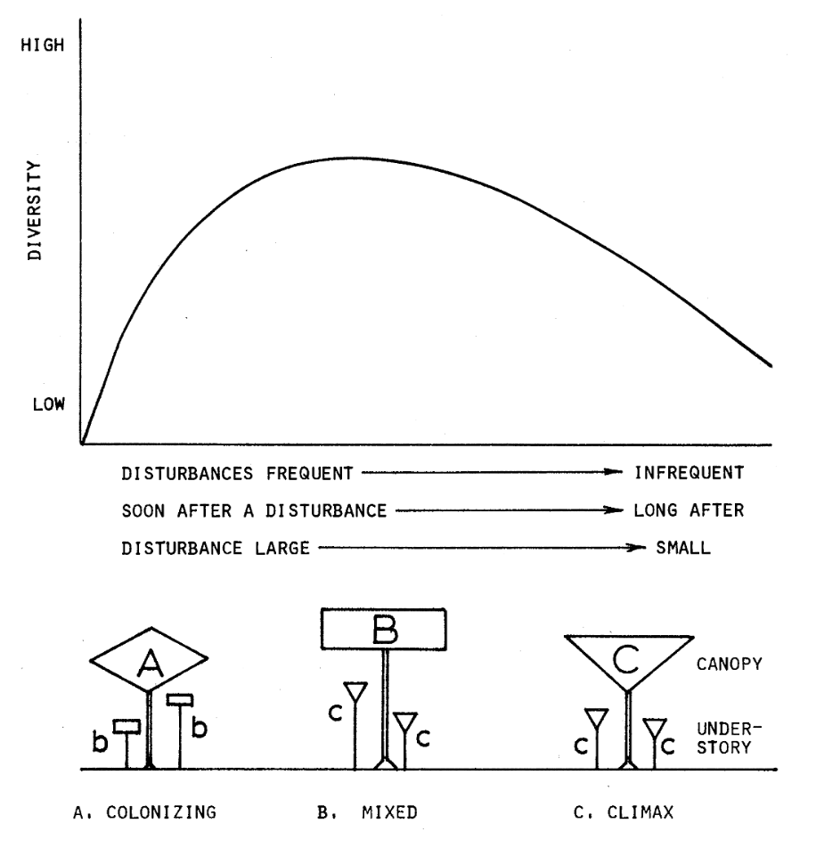
The Intermediate Disturbance Hypothesis states that species diversity should be maximized at levels of intermediate disturbance in which both r-selected and K-selected species can coexist.
r-selected species dominate
K-selected species dominate
Connell 1978. Science.

Slide 50
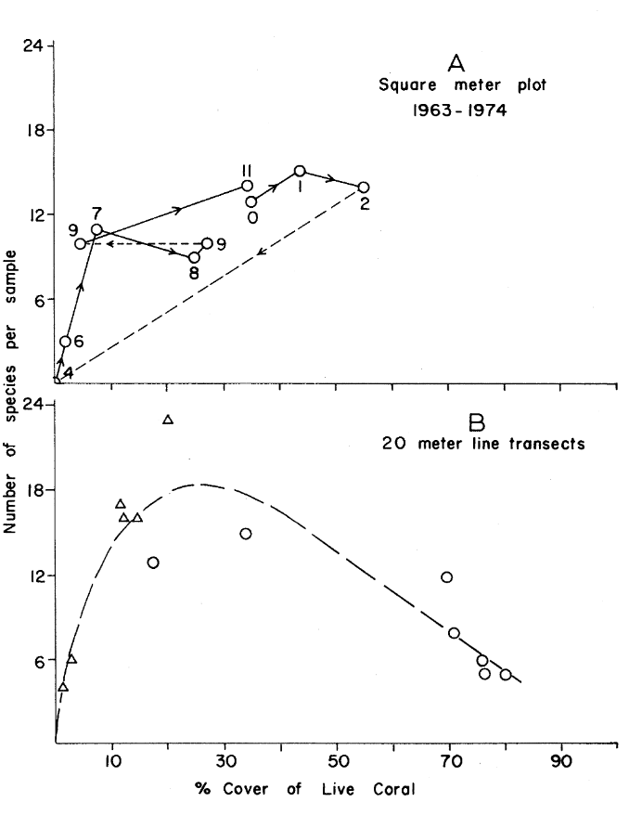
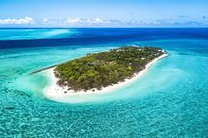
The Intermediate Disturbance Hypothesis states that species diversity should be maximized at levels of intermediate disturbance in which both r-selected and K-selected species can coexist.
Heron Island, Australia
r-selected species dominate
K-selected species dominate
Sometimes it seems to be correct!
Connell 1978. Science.

Slide 51
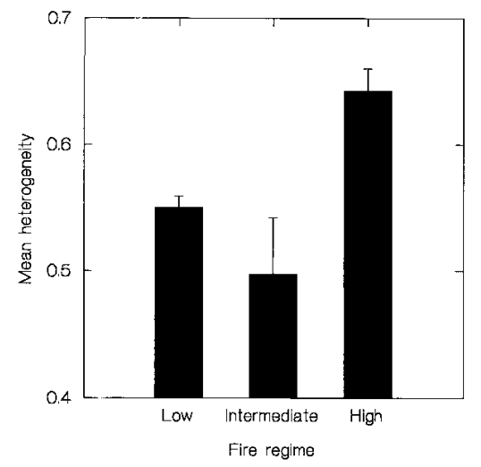
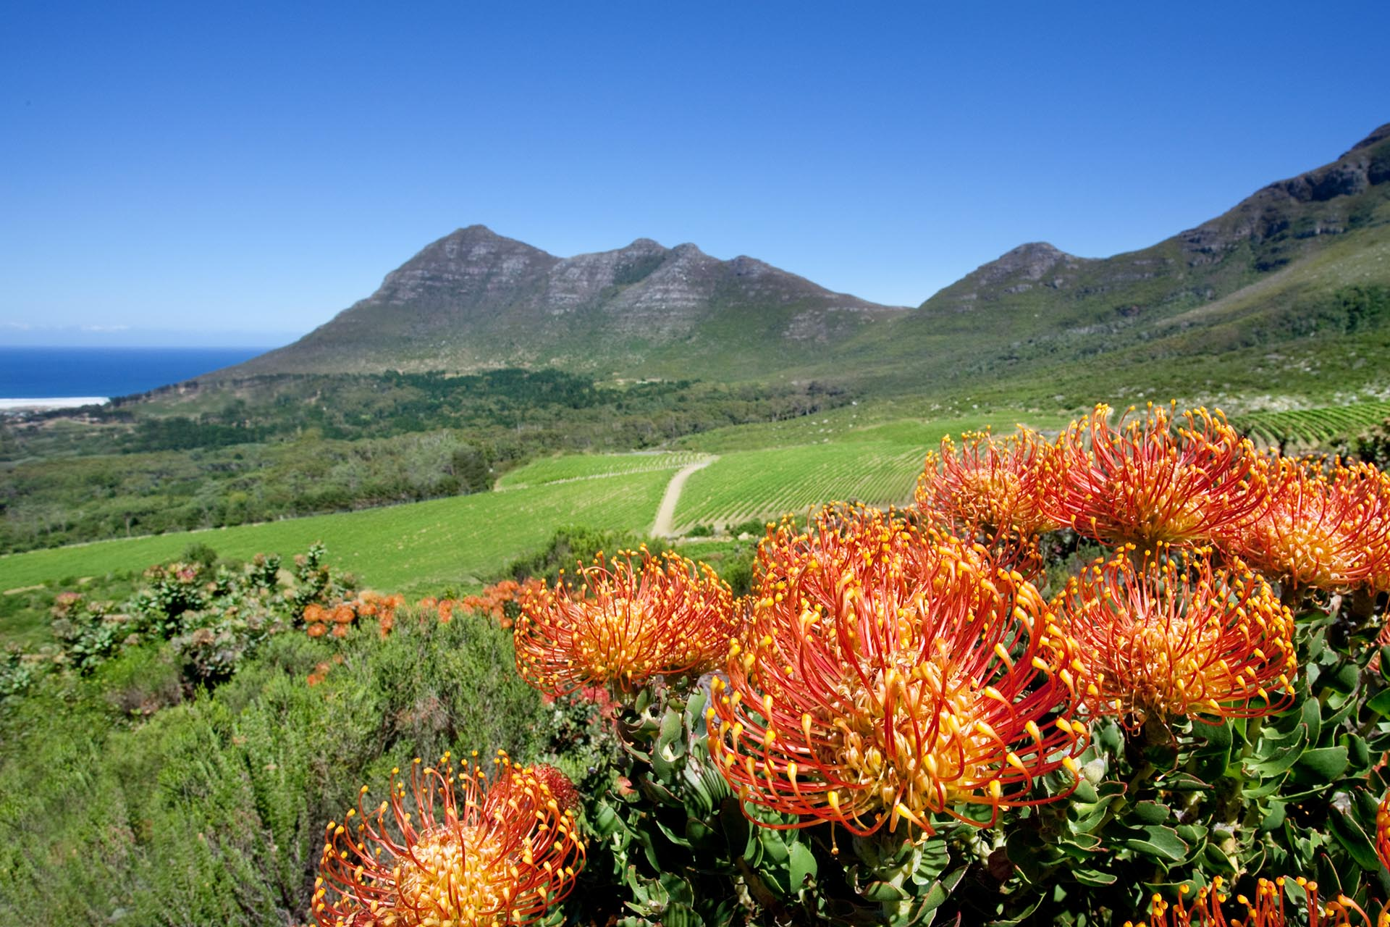
The Intermediate Disturbance Hypothesis states that species diversity should be maximized at levels of intermediate disturbance in which both r-selected and K-selected species can coexist.
Sometimes it is not so well-supported empirically!
r-selected species dominate
K-selected species dominate
Schwik et al. 1997. Plant Ecology

Slide 52
What is a model?
The IDH gives an example of a model that is often wrong but still useful in generating testable hypotheses.
an abstract representation of a phenomenon
Solar System
Climate
Human
Human Genetics
Human Disease
Species Distribution
Notes:
an abstract representation of a phenomenon

Slide 53
The field of biogeography studies the geographical distribution of plants and animals

Slide 54
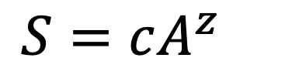
The field of biogeography studies the geographical distribution of plants and animals
Larger areas have more species!
$$S=cA^{z}$$
Preston 1964. Ecology

Slide 55
The field of biogeography studies the geographical distribution of plants and animals
Larger areas have more species!
$$S=cA^{z}$$
number of species
habitat area
Preston 1964. Ecology

Slide 56
The field of biogeography studies the geographical distribution of plants and animals
Larger areas have more species!
$$S=cA^{z}$$
slope of relationship in log-log space
number of species
habitat area
Preston 1964. Ecology

Slide 57
The field of biogeography studies the geographical distribution of plants and animals
Larger areas have more species!
$$S=cA^{z}$$
slope of relationship in log-log space
number of species
habitat area
constant based on unit of area
(standardizes to expected number of species per single unit area)
Preston 1964. Ecology

Slide 58
The field of biogeography studies the geographical distribution of plants and animals
Larger areas have more species!
The slope of the log-log relationship (z) will differ across diverse communities and ecosystems.
$$S=cA^{z}$$
Preston 1964. Ecology

Slide 59
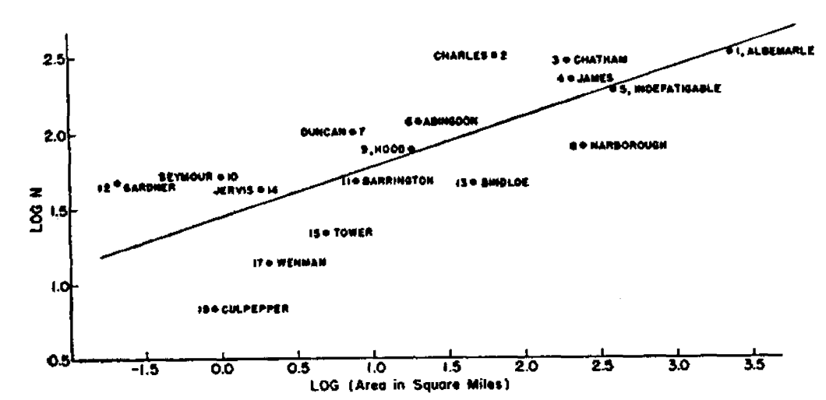
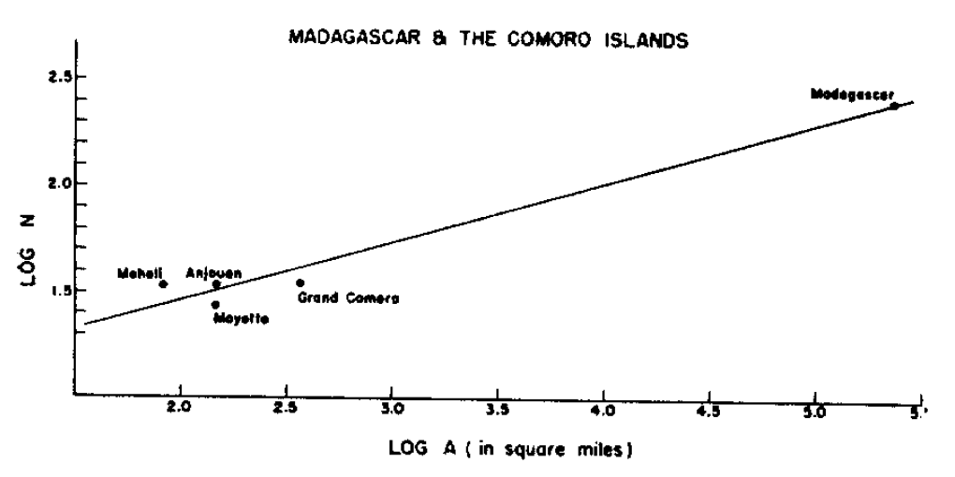
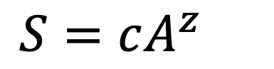
The field of biogeography studies the geographical distribution of plants and animals
Plant species of the Galapagos islands
Larger areas have more species!
The slope of the log-log relationship (z) will differ across diverse communities and ecosystems.
$$S=cA^{z}$$
Bird species of Madagascar and the Comoros
Preston 1964. Ecology

Slide 60
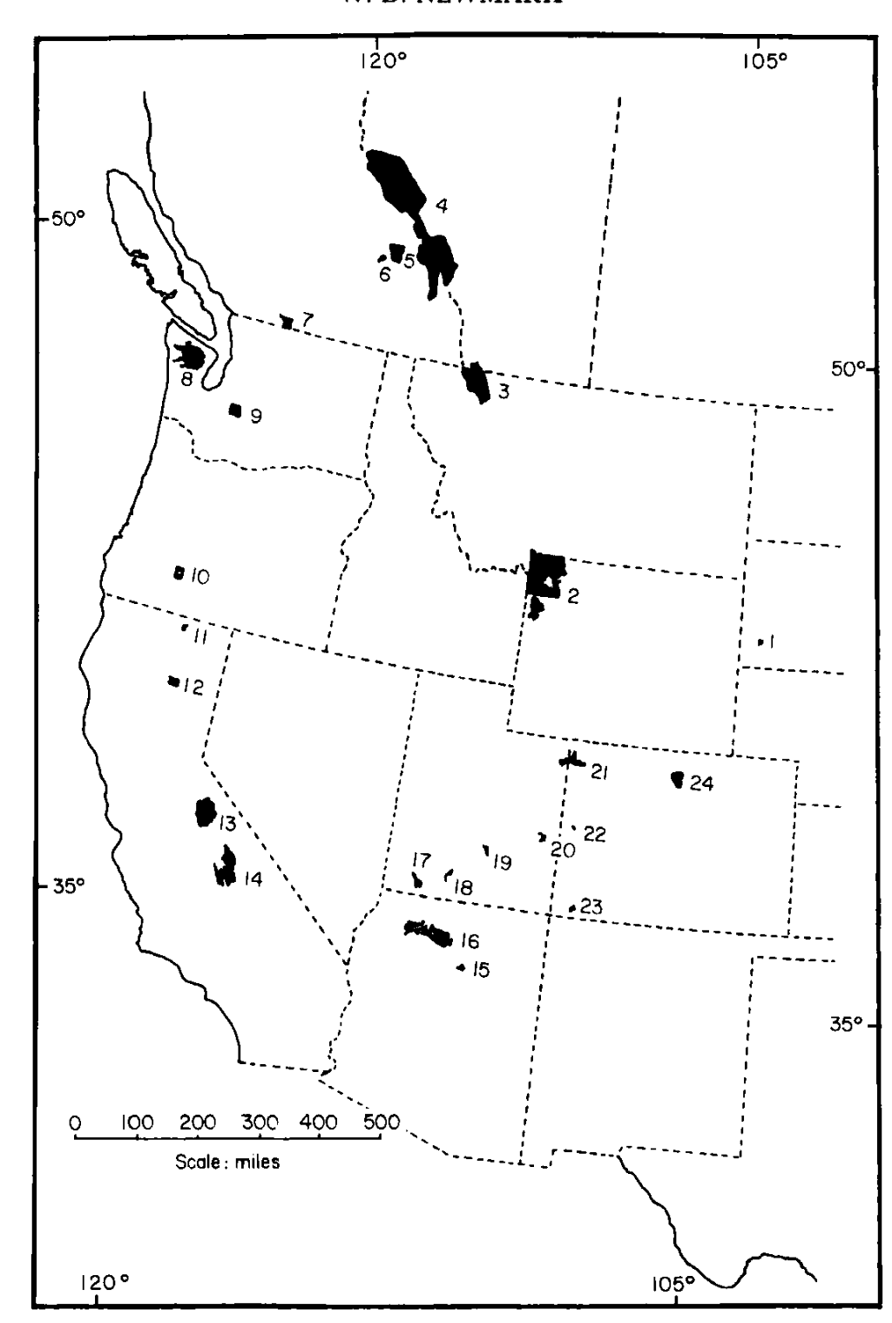
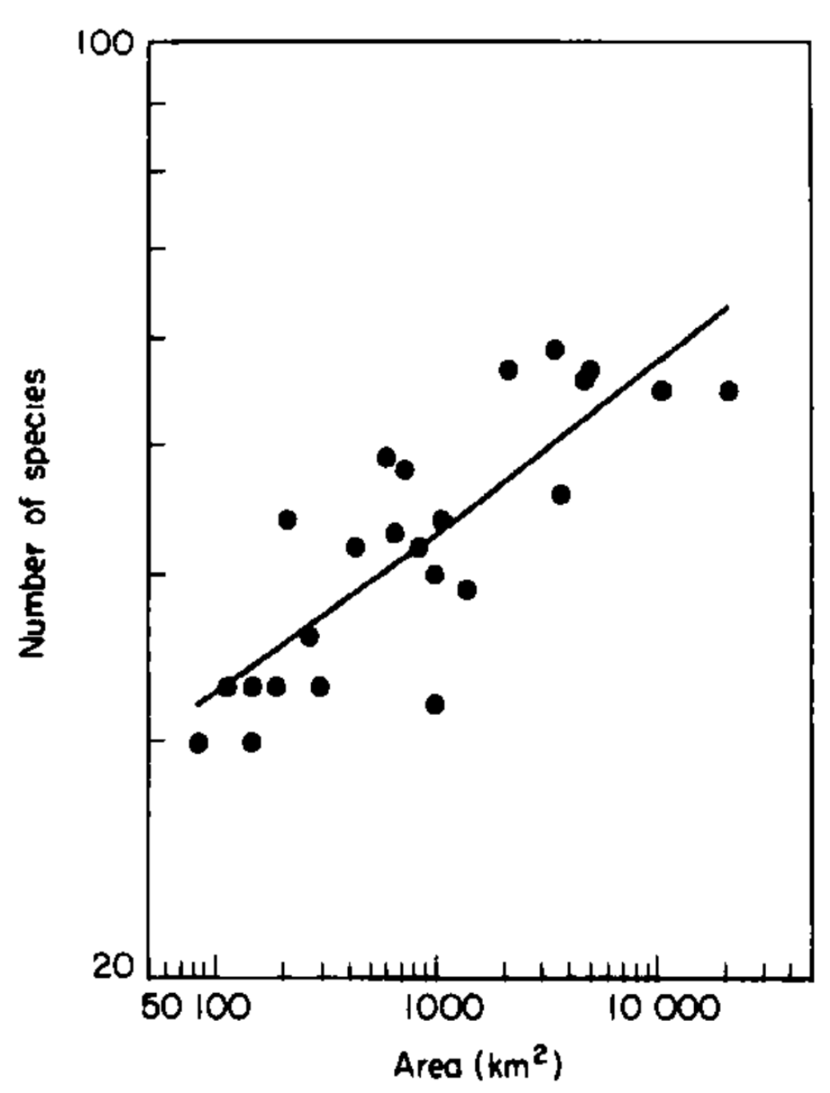
The field of biogeography studies the geographical distribution of plants and animals.
Mammal species of western US national parks
Larger areas have more species!
The slope of the log-log relationship (z) will differ across diverse communities and ecosystems.
$$S=cA^{z}$$
Newmark 1986. Biological Journal of the Linnean Society.

Slide 61
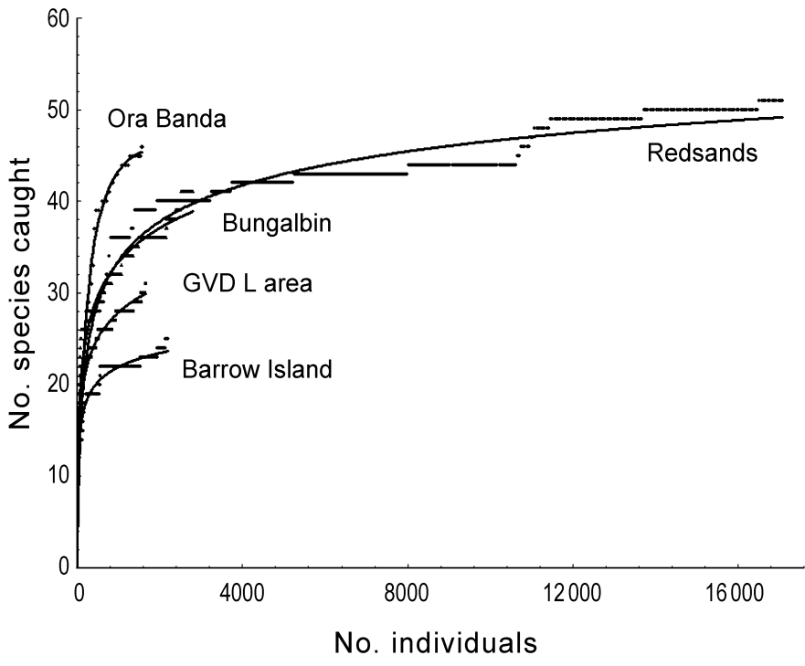
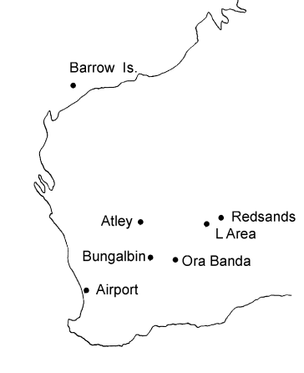
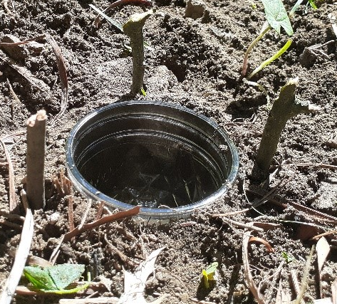
We can use the species-area relationship (SAR) to build species accumulation curves to understand if we have representatively sampled a population in field studies.
No. species captured
No. individuals captured
Thompson 2003. Animal Ecology.

Slide 62

Building on the species-area relationship (SAR), MacArthur and Wilson proposed the theory of island biogeography.
MacArthur and Wilson. 1963. Evolution.
MacArthur and Wilson. 1967. The Theory of Island Biogeography.

Slide 63
Building on the species-area relationship (SAR), MacArthur and Wilson proposed the theory of island biogeography.
This theory offers a null model for the number of species found in a given habitat, predictable from both the size of the habitat and its distance from a source population.
MacArthur and Wilson. 1963. Evolution.
MacArthur and Wilson. 1967. The Theory of Island Biogeography.

Slide 64
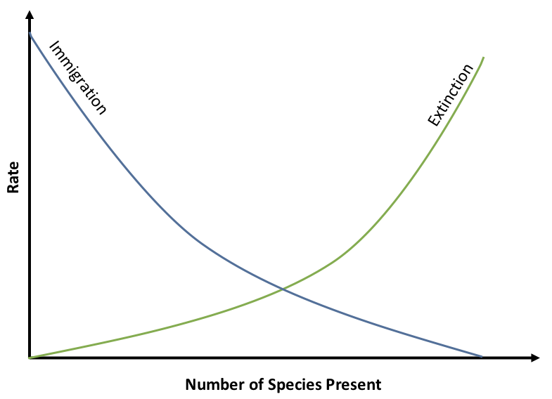
The theory of island biogeography offers a null model for the number of species found in a given habitat, predictable from both the size of the habitat and its distance from a source population.
The equilibrium number of species in
an “island” habitat is reached when:
the rate of immigration = the rate of extinction
MacArthur and Wilson. 1963. Evolution.
MacArthur and Wilson. 1967. The Theory of Island Biogeography.

Slide 65
The theory of island biogeography offers a null model for the number of species found in a given habitat, predictable from both the size of the habitat and its distance from a source population.
Species area-effect: Larger islands have lower extinction rates because they provide more habitat to sustain more species. Allee effects reduced at larger population sizes.
The equilibrium number of species in
an “island” habitat is reached when:
the rate of immigration = the rate of extinction
N=100
N=10
MacArthur and Wilson. 1963. Evolution.
MacArthur and Wilson. 1967. The Theory of Island Biogeography.

Slide 66
The theory of island biogeography offers a null model for the number of species found in a given habitat, predictable from both the size of the habitat and its distance from a source population.
Distance effect: Closer islands have higher immigration rates because it’s easier for organisms to disperse across short distances.
Species area-effect: Larger islands have lower extinction rates because they provide more habitat to sustain more species. Allee effects reduced at larger population sizes.
The equilibrium number of species in
an “island” habitat is reached when:
the rate of immigration = the rate of extinction
N=100
N=10
MacArthur and Wilson. 1963. Evolution.
MacArthur and Wilson. 1967. The Theory of Island Biogeography.

Slide 67
The theory of island biogeography offers a null model for the number of species found in a given habitat, predictable from both the size of the habitat and its distance from a source population.
Distance effect: Closer islands have higher immigration rates because it’s easier for organisms to disperse across short distances.
Species area-effect: Larger islands have lower extinction rates because they provide more habitat to sustain more species. Allee effects reduced at larger population sizes.
The equilibrium number of species in
an “island” habitat is reached when:
the rate of immigration = the rate of extinction
close islands
small islands
large islands
N=100
far islands
N=10
MacArthur and Wilson. 1963. Evolution.
MacArthur and Wilson. 1967. The Theory of Island Biogeography.

Slide 68
The theory of island biogeography offers a null model for the number of species found in a given habitat, predictable from both the size of the habitat and its distance from a source population.
Distance effect: Closer islands have higher immigration rates because it’s easier for organisms to disperse across short distances.
Species area-effect: Larger islands have lower extinction rates because they provide more habitat to sustain more species. Allee effects reduced at larger population sizes.
The equilibrium number of species in
an “island” habitat is reached when:
the rate of immigration = the rate of extinction
close islands
small islands
large islands
N=100
far islands
turnover rate for far-small
N=10
MacArthur and Wilson. 1963. Evolution.
MacArthur and Wilson. 1967. The Theory of Island Biogeography.
S*: far-small
S*: far-large
S*: close-large
S*: close-small

Slide 69
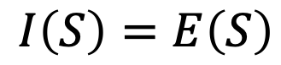
The theory of island biogeography offers a null model for the number of species found in a given habitat, predictable from both the size of the habitat and its distance from a source population.
Distance effect: Closer islands have higher immigration rates because it’s easier for organisms to disperse across short distances.
Species area-effect: Larger islands have lower extinction rates because they provide more habitat to sustain more species. Allee effects reduced at larger population sizes.
The equilibrium number of species in
an “island” habitat is reached when:
the rate of immigration = the rate of extinction
$$I\left(S\right)=E\left(S\right)$$
MacArthur and Wilson. 1963. Evolution.
MacArthur and Wilson. 1967. The Theory of Island Biogeography.

Slide 70

The theory of island biogeography offers a null model for the number of species found in a given habitat, predictable from both the size of the habitat and its distance from a source population.
Distance effect: Closer islands have higher immigration rates because it’s easier for organisms to disperse across short distances.
Species area-effect: Larger islands have lower extinction rates because they provide more habitat to sustain more species. Allee effects reduced at larger population sizes.
The equilibrium number of species in
an “island” habitat is reached when:
the rate of immigration = the rate of extinction
$$I\left(S\right)=E\left(S\right)$$
$$E(S)={Se}^{−εA}$$
number of species on island
fit parameter scaling effect of area on extinction
area of habitat
MacArthur and Wilson. 1963. Evolution.
MacArthur and Wilson. 1967. The Theory of Island Biogeography.

Slide 71

The theory of island biogeography offers a null model for the number of species found in a given habitat, predictable from both the size of the habitat and its distance from a source population.
Distance effect: Closer islands have higher immigration rates because it’s easier for organisms to disperse across short distances.
Species area-effect: Larger islands have lower extinction rates because they provide more habitat to sustain more species. Allee effects reduced at larger population sizes.
The equilibrium number of species in
an “island” habitat is reached when:
the rate of immigration = the rate of extinction
$$I\left(S\right)=E\left(S\right)$$
$$I(S)={i\left(P−S\right)e}^{−φd}$$
$$E(S)={Se}^{−εA}$$
distance from island to source population
immigration rate
number of species on island
area of habitat
number of species on island
fit parameter scaling effect of area on extinction
total number of species in pool
fit parameter governing distance decay on immigration rate
MacArthur and Wilson. 1963. Evolution.
MacArthur and Wilson. 1967. The Theory of Island Biogeography.

Slide 72
The theory of island biogeography offers a null model for the number of species found in a given habitat, predictable from both the size of the habitat and its distance from a source population.
Distance effect: Closer islands have higher immigration rates because it’s easier for organisms to disperse across short distances.
Species area-effect: Larger islands have lower extinction rates because they provide more habitat to sustain more species. Allee effects reduced at larger population sizes.
The equilibrium number of species in
an “island” habitat is reached when:
the rate of immigration = the rate of extinction
$$I\left(S\right)=E\left(S\right)$$
$$I(S)={i\left(P−S\right)e}^{−φd}$$
$$E(S)={Se}^{−εA}$$
distance from island to source population
immigration rate
number of species on island
area of habitat
number of species on island
fit parameter scaling effect of area on extinction
total number of species in pool
fit parameter governing distance decay on immigration rate
MacArthur and Wilson. 1963. Evolution.
MacArthur and Wilson. 1967. The Theory of Island Biogeography.

Slide 73


The theory of island biogeography offers a null model for the number of species found in a given habitat, predictable from both the size of the habitat and its distance from a source population.
The equilibrium number of species in
an “island” habitat is reached when:
the rate of immigration = the rate of extinction
$$I\left(S\right)=E\left(S\right)$$
$$S^{∗}=\frac{iPe^{εA}}{ie^{εA}+e^{φd}}$$
MacArthur and Wilson. 1963. Evolution.
MacArthur and Wilson. 1967. The Theory of Island Biogeography.

Slide 74
The theory of island biogeography offers a null model for the number of species found in a given habitat, predictable from both the size of the habitat and its distance from a source population.
The equilibrium number of species in
an “island” habitat is reached when:
the rate of immigration = the rate of extinction
increases with number of species in source pool
increases with area of island
$$S^{∗}=\frac{iPe^{εA}}{ie^{εA}+e^{φd}}$$
decreases with distance from with distance from mainland
equilibrium number of species
MacArthur and Wilson. 1963. Evolution.
MacArthur and Wilson. 1967. The Theory of Island Biogeography.

Slide 75
Extensions to the theory of island biogeography…
Species area-effect: Larger islands have lower extinction rates because they provide more habitat to sustain more species. Allee effects reduced at larger population sizes.
Distance effect: Closer islands have higher immigration rates because it’s easier for organisms to disperse across short distances.
The equilibrium number of species in
an “island” habitat is reached when:
the rate of immigration = the rate of extinction
N=100
N=10
MacArthur and Wilson. 1963. Evolution.
MacArthur and Wilson. 1967. The Theory of Island Biogeography.

Slide 76

Extensions to the theory of island biogeography…
Species area-effect: Larger islands have lower extinction rates because they provide more habitat to sustain more species. Allee effects reduced at larger population sizes.
Distance effect: Closer islands have higher immigration rates because it’s easier for organisms to disperse across short distances.
The equilibrium number of species in
an “island” habitat is reached when:
the rate of immigration = the rate of extinction
Rescue effect: Closer islands have lower extinction rates because they can be repopulated from the mainland!
Target effect: larger islands have higher immigration rates because they offer a bigger target to land on!
MacArthur and Wilson. 1963. Evolution.
MacArthur and Wilson. 1967. The Theory of Island Biogeography.

Slide 77



Wilson and Simberloff field-tested this theory in the Florida Keys!
Wilson and Simberloff identified seven mangrove islands in the Florida Keys varying in size from 11-18m in diameter and catalogued their fauna (all arthropods).
They also conducted surveys across the keys to quantify the entire possible “source” pool to the islands.
The experimental islands were then fumigated with methyl bromide at levels lethal to arthropods but not to plants.
They catalogued their progressive recolonization after fumigation, tracking its predictability based on size and distance of these islands to the source pool.
Simberloff. 1969. Ecology.
Wilson and Simberloff. 1969. Ecology.
Simberloff and Wilson. 1969. Ecology.

Slide 78


Wilson and Simberloff field-tested this theory in the Florida Keys!
Islands were recolonized to pre-defaunation levels rapidly, within a year!
Though the equilibrium number of species was the same, the identity was quite different – only about 40% similar to the original censuses.
Strong flyers recolonized first but were eventually replaced (outcompeted) by better competitors (typically ants) – in keeping with theories of faunal succession.
The islands farthest from the mainland were the slowest to recolonize.
Simberloff. 1969. Ecology.
Wilson and Simberloff. 1969. Ecology.
Simberloff and Wilson. 1969. Ecology.

Slide 79



In subsequent work, Simberloff demonstrated the area effect by actually removing entire chunks out of islands and censusing species!
log-log plot of island area and species count before and after land removal!
Pre-land removal species accumulation curves demonstrate that a sufficient quantity of biodiversity was sampled.
Simberloff. 1976. Ecology.

Slide 80


Island biogeography has greatly influenced the design of protected area reserves
Area effect:
Island size and resident, non-marine bird species number near New Guinea
Distance effect:
Island resident, non-marine bird species count by distance from New Guinea (standardized by area)
Diamond. 1975. Biological Conservation.

Slide 81



Island biogeography has greatly influenced the design of protected area reserves
Mammalian extirpations post-establishment by area size in western North American national parks
“SLOSS” debate
(1970s-1980s)
Reserve design estimated to protect the largest number of species based on island biogeography theory
Newmark. 1987. Nature.
Diamond. 1975. Biological Conservation.

Slide 82
Biodiversity can be measured in several ways!

Slide 83
Biodiversity can be measured in several ways!
Landscape A
Site 1
Site 2
Whittaker. 1960. Ecological Monographs.

Slide 84

Biodiversity can be measured in several ways!
(here = 3)
$α$ – diversity = species richness, typically within a small specified region
Landscape A
Site 1
Site 2
(here = 4)
Whittaker. 1960. Ecological Monographs.

Slide 85

Biodiversity can be measured in several ways!
(here = 3)
$α$ – diversity = species richness, typically within a small specified region
Landscape A
Site 1
$γ$ – diversity = total species diversity in a the landscape (here = 5)
Site 2
(here = 4)
Whittaker. 1960. Ecological Monographs.

Slide 86


Biodiversity can be measured in several ways!
(here = 3)
(here = 1.67 or 2)
$α$ – diversity = species richness, typically within a small specified region
Landscape A
Site 1
$γ$ – diversity = total species diversity in a the landscape (here = 5)
Site 2
(here = 1.25 or 1)
$β$– diversity = ratio between landscape and local species diversity, either $\left(\frac{γ}{α}\right)$ or $\left(γ\text{-}α\right)$
Site 1 has lower $α$– diversity but higher $β$– diversity than site 2. Both are important!
(here = 4)
Whittaker. 1960. Ecological Monographs.

Slide 87

Biodiversity is concentrated in the tropics.
(terrestrial vertebrate diversity)
Mannion. 2014. Trends in Ecology & Evolution.

Slide 88
Biodiversity is concentrated in the tropics.
We still lack a satisfying model to explain why.
(terrestrial vertebrate diversity)
Mannion. 2014. Trends in Ecology & Evolution.

Slide 89
Biodiversity is concentrated in the tropics.
We still lack a satisfying model to explain why.
Some candidate hypotheses:
Geographical area hypothesis. More area in the tropics = more species… but there’s just as much area north of the tropics and fewer species!
Species-energy hypothesis. Increased solar energy at low latitudes causes increased net primary productivity (or photosynthesis) and drives accumulation of species up the food web…but offers a better prediction for abundance and biomass than for numbers of species.
Historical perturbation hypothesis. Polar regions have not yet recovered equilibrium species numbers after glaciation… but does not hold for marine systems, where the latitudinal gradient still exists…
Biotic interactions hypothesis. More species yield more species as processes of competition, predation, etc. are intensified in the tropics… but cannot provide the basal cause for the accumulation of more species to begin with!
Mannion. 2014. Trends in Ecology & Evolution.

Slide 90

Vector-borne and parasitic diseases are also concentrated in the tropics - where income is correspondingly low.
Bonds et al. 2012. PLoS Biology.

Slide 91
Why do we care about biodiversity?

Slide 92


Why do we care about biodiversity?
Cedar Creek experiment from the University of Minnesota
Tilman et al. 2006. Nature.

Slide 93
Why do we care about biodiversity?
mean plant biomass / standard deviation in plant biomass
(a proxy for primary productivity)
Cedar Creek experiment from the University of Minnesota
number of species comprising 90% of aboveground biomass (very rare species excluded)
Tilman et al. 2006. Nature.

Slide 94
Why do we care about biodiversity?
Tilman et al. 2006. Nature.
“Our results indicate that the reliable, efficient and sustainable supply of some foods, biofuels and ecosystem services can be enhanced by the use of biodiversity.”
mean plant biomass / standard deviation in plant biomass
(a proxy for primary productivity)
number of species comprising 90% of aboveground biomass (very rare species excluded)
Biodiversity promotes ecosystem “stability”, meaning that ecosystems are more likely to perform their essential functions when they are more diverse!

Slide 95




Biodiversity performs important functions, including those which benefit humans, known as ecosystem services.
regulating services
provisioning services
water and air purification
carbon sequestration
pollination
pest (and sometimes disease) control
food (fish, game)
raw materials (lumber, skins, organic matter)
medicinal resources
ornamental resources
cultural services
supporting services
ecotourism
therapeutic services
historical and cultural values
nutrient cycling
primary productivity
habitat provisioning

Slide 96





The Natural Capital Project seeks to value the economic benefits of ecosystem services for humans.

Slide 97
The Natural Capital Project seeks to value the economic benefits of ecosystem services for humans.
The Catskill-Delaware watershed supplies 1.2 billion gallons of drinking water daily to 9 million residents of New York City.
Through the 1980s, NYC water remained the purest in the nation, regularly beating bottled waters in blind taste and purity tests, and was even imported to England for tea tasting.
Towards the late 1980s early 1990s, the water quality began to decline, and NYC faced the prospect of building a water filtration plant, costing ~$6 billion to build and another $250 million annually to maintain.
Instead, in 1997, the city embarked on a $1.5 billion plant to preserve the Catskills watershed, buying thousands of upstate acres, shielding reservoirs from pollution, and subsidizing environmentally-sound economic development.
To this day, NYC’s tap water remains clean and unfiltered.

Slide 98
The Natural Capital Project seeks to value the economic benefits of ecosystem services for humans.
The Catskill-Delaware watershed supplies 1.2 billion gallons of drinking water daily to 9 million residents of New York City.
Through the 1980s, NYC water remained the purest in the nation, regularly beating bottled waters in blind taste and purity tests, and was even imported to England for tea tasting.
Towards the late 1980s early 1990s, the water quality began to decline, and NYC faced the prospect of building a water filtration plant, costing ~$6 billion to build and another $250 million annually to maintain.
Instead, in 1997, the city embarked on a $1.5 billion plant to preserve the Catskills watershed, buying thousands of upstate acres, shielding reservoirs from pollution, and subsidizing environmentally-sound economic development.
To this day, NYC’s tap water remains clean and unfiltered.

Slide 99
The Natural Capital Project seeks to value the economic benefits of ecosystem services for humans.
The Catskill-Delaware watershed supplies 1.2 billion gallons of drinking water daily to 9 million residents of New York City.
Through the 1980s, NYC water remained the purest in the nation, regularly beating bottled waters in blind taste and purity tests, and was even imported to England for tea tasting.
Towards the late 1980s early 1990s, the water quality began to decline, and NYC faced the prospect of building a water filtration plant, costing ~$6 billion to build and another $250 million annually to maintain.
Instead, in 1997, the city embarked on a $1.5 billion plant to preserve the Catskills watershed, buying thousands of upstate acres, shielding reservoirs from pollution, and subsidizing environmentally-sound economic development.
To this day, NYC’s tap water remains clean and unfiltered.

Slide 100
The Natural Capital Project seeks to value the economic benefits of ecosystem services for humans.
The Catskill-Delaware watershed supplies 1.2 billion gallons of drinking water daily to 9 million residents of New York City.
Through the 1980s, NYC water remained the purest in the nation, regularly beating bottled waters in blind taste and purity tests, and was even imported to England for tea tasting.
Towards the late 1980s early 1990s, the water quality began to decline, and NYC faced the prospect of building a water filtration plant, costing ~$6 billion to build and another $250 million annually to maintain.
Instead, in 1997, the city embarked on a $1.5 billion plant to preserve the Catskills watershed, buying thousands of upstate acres, shielding reservoirs from pollution, and subsidizing environmentally-sound economic development.
To this day, NYC’s tap water remains clean and unfiltered.

Slide 101
The Natural Capital Project seeks to value the economic benefits of ecosystem services for humans.
The Catskill-Delaware watershed supplies 1.2 billion gallons of drinking water daily to 9 million residents of New York City.
Through the 1980s, NYC water remained the purest in the nation, regularly beating bottled waters in blind taste and purity tests, and was even imported to England for tea tasting.
Towards the late 1980s early 1990s, the water quality began to decline, and NYC faced the prospect of building a water filtration plant, costing ~$6 billion to build and another $250 million annually to maintain.
Instead, in 1997, the city embarked on a $1.5 billion plant to preserve the Catskills watershed, buying thousands of upstate acres, shielding reservoirs from pollution, and subsidizing environmentally-sound economic development.
To this day, NYC’s tap water remains clean and unfiltered.

Slide 102

Five major mass extinction events are recognized in geologic time.
Mass extinctions are characterized by the loss of >75% of species within a geologically “short” timespan.
Raup and Sepkoski. 1982. Science
Notes:
Ordovician–Silurian extinction events (End Ordovician or O–S): 445–444 Ma, just prior to and at the Ordovician–Silurian transition. Two events occurred that killed off 27% of all families, 57% of all genera and 85% of all species.^{[6]} Together they are ranked by many scientists as the second-largest of the five major extinctions in Earth's history in terms of percentage of genera that became extinct. In May 2020, studies suggested that the causes of the mass extinction were global warming, related to volcanism, and anoxia, and not, as considered earlier, cooling and glaciation.^{[7][8]} However, this is at odds with numerous previous studies, which have indicated global cooling as the primary driver.^{[9]} Most recently, the deposition of volcanic ash has been suggested to be the trigger for reductions in atmospheric carbon dioxide leading to the glaciation and anoxia observed in the geological record.^{[10]}
Late Devonian extinctions: 372–359 Ma, occupying much of the Late Devonian up to the Devonian–Carboniferous transition. The Late Devonian was an interval of high diversity loss, concentrated into two extinction events. The largest extinction was the Kellwasser Event (Frasnian-Famennian, or F-F, 372 Ma), an extinction event at the end of the Frasnian, about midway through the Late Devonian. This extinction annihilated coral reefs and numerous tropical benthic (seabed-living) animals such as jawless fish, brachiopods, and trilobites. Another major extinction was the Hangenberg Event (Devonian-Carboniferous, or D-C, 359 Ma), which brought an end to the Devonian as a whole. This extinction wiped out the armored placoderm fish and nearly led to the extinction of the newly-evolved ammonoids. These two closely-spaced extinction events collectively eliminated about 19% of all families, 50% of all genera^{[6]} and at least 70% of all species.^{[11]} Sepkoski and Raup (1982) did not initially consider the Late Devonian extinction interval (Givetian, Frasnian, and Famennian stages) to be statistically significant.^{[2]} Regardless, later studies have affirmed the strong ecological impacts of the Kellwasser and Hangenberg Events.^{[12]}
3. Permian–Triassic extinction event (End Permian): 252 Ma, at the Permian–Triassic transition.^{[13]} Earth's largest extinction killed 57% of all families, 83% of all genera and 90% to 96% of all species^{[6]} (53% of marine families, 84% of marine genera, about 81% of all marine species^{[14]} and an estimated 70% of land species,^{[15][16]} including insects).^{[17]} The highly successful marine arthropod, the trilobite, became extinct. The evidence regarding plants is less clear, but new taxa became dominant after the extinction.^{[18]} The "Great Dying" had enormous evolutionary significance: On land, it ended the primacy of early synapsids. The recovery of vertebrates took 30 million years,^{[19]} but the vacant niches created the opportunity for archosaurs to become ascendant. In the seas, the percentage of animals that were sessile dropped from 67% to 50%. The whole late Permian was a difficult time, at least for marine life, even before the P–T boundary extinction. More recent research has indicated that the End-Capitanian extinction event that preceded the "Great Dying" likely constitutes a separate event from the P–T extinction; if so, it would be larger than some of the "Big Five" extinction events, and perhaps merit a separate place in this list immediately before this one.
4. Triassic–Jurassic extinction event (End Triassic): 201.3 Ma, at the Triassic–Jurassic transition. About 23% of all families, 48% of all genera (20% of marine families and 55% of marine genera) and 70% to 75% of all species became extinct.^{[6]} Most non-dinosaurian archosaurs, most therapsids, and most of the large amphibians were eliminated, leaving dinosaurs with little terrestrial competition. Non-dinosaurian archosaurs continued to dominate aquatic environments, while non-archosaurian diapsids continued to dominate marine environments. The Temnospondyl lineage of large amphibians also survived until the Cretaceous in Australia (e.g., Koolasuchus).
5. Cretaceous–Paleogene extinction event (End Cretaceous, K–Pg extinction, or formerly K–T extinction): 66 Ma, at the Cretaceous (Maastrichtian) – Paleogene (Danian) transition.^{[20]} The event was formerly called the Cretaceous-Tertiary or K–T extinction or K–T boundary; it is now officially named the Cretaceous–Paleogene (or K–Pg) extinction event. About 17% of all families, 50% of all genera^{[6]} and 75% of all species became extinct.^{[2]} In the seas all the ammonites, plesiosaurs and mosasaurs disappeared and the percentage of sessile animals (those unable to move about) was reduced to about 33%. All non-avian dinosaurs became extinct during that time.^{[21]} The boundary event was severe with a significant amount of variability in the rate of extinction between and among different clades. Mammals and birds, the former descended from the synapsids and the latter from theropod dinosaurs, emerged as dominant terrestrial animals

Slide 103
Five major mass extinction events are recognized in geologic time.
Mass extinctions are characterized by the loss of >75% of species within a geologically “short” timespan.
Number marine vertebrate and invertebrate families preserved in the fossil record
present day
Raup and Sepkoski. 1982. Science

Slide 104

We are living through the sixth mass extinction:
the Holocene, or Anthropocene extinction
Mass megafaunal extinctions followed human arrival to each continent, in North America timed around the end of the Pleistocene (~10-14,000 years ago).
Today, the contemporary rate of extinction is estimated at 100 to 1000 times higher than background (e.g. historically typical) and 10 to 100 times higher than previously witness during the 5 previous mass extinction events in earth history.
The current extinct rate is considered to be anthropogenic in origin.

Slide 105


Slide 106
Want more ecology?
BIOS 23232. Ecology and Evolution in the Southwest.
Instructor: Eric Larsen. Term: Spring
BIOS 23249. Animal Behavior.
Instructor: Jill Mateo. Term: Winter
BIOS 23254. Mammalian Ecology.
Instructor: Eric Larsen. Term: Spring
BIOS 23289. Marine Ecology.
Instructor: Tim Wootton. Term: Winter
BIOS 23409. The Ecology and Evolution of Infectious Diseases.
Instructor: Greg Dwyer. Term: Spring
BIOS 23410. Complex Interactions: Coevolution, Parasites, Mutualists, and Cheaters.
Instructor: Thorsten Lumbsch. Term: Spring

Slide 107


The Janzen-Connell Hypothesis explains the maintenance of tree diversity in tropical forests.
number of seeds per unit area
probability seed will mature
population recruitment curve
Janzen 1970. The American Naturalist
Connell 1970. Dynamics of Population

